Slide 1

Basic Details of the Team and Problem Statement
Ministry/Organization Name/Student Innovation:
PS Code: 1355
Problem Statement Title: Developing solutions to effective market linkage and promotion of One District One Product
Team Name: Tech Titans
Team Leader Name: Shreyas Aher
Institute Code (AISHE): 6145
Institute Name: JSPM’s Jaywantrao Sawant College of Engineering
Theme Name: Heritage and Culture

Slide 2
One District One Product (ODOP) is a government-led initiative aimed at promoting and marketing the unique and diverse products of Jammu and Kashmir. The program was launched with the goal of providing a platform for the local artisans and entrepreneurs to showcase their skills and to promote the local products. The focus of the initiative is to encourage the development of small and micro-enterprises, thereby creating job opportunities and boosting the local economy. The ODOP initiative covers a wide range of products, including traditional handicrafts, textiles, carpets, shawls, and dry fruits, among others. The products are manufactured using locally sourced materials, preserving the rich cultural heritage of the region. The initiative also focuses on modernizing the traditional production methods, thereby improving the quality and consistency of the products being produced. UT of Jammu and Kashmir is endowed with several diverse and niche products from each district. Ranging from high-value agricultural and horticultural produce to unique handicraft and textile products. Yet, several challenges still persist in wider outreach and equitable remuneration to local producers and artisans. Scope for developing unique software-based solutions exist at each stage from producers to final consumers; including innovative solutions for ensuring traceability through block chain, to development of platforms for direct market linkages etc. Proposal are expected to provide an in-depth understanding of the supply chain and the involved stakeholders, of specific ODOP and design hardware or software-based solution to address the challenges of a fragmented supply chain.
DESCRIPTION:

Slide 3

Idea/Approach Details
Describe your idea/Solution/Prototype here:
To create an online platform that would help the local vendors ,craftsmen and regional businessmen to showcase their art,craft,textiles,clothing ,etc. to a wide range of people.
To make the people accessible to direct market.
To overcome several challenges that still persist in wider outrage and equitable renumeration to local producers and artisans.
JAMMU AND KASHMIR
Describe your Technology stack here:
Frontend:Javascript , CSS
Backend: Python
Android Studio
Firebase Authentication
UI/UX

Slide 4
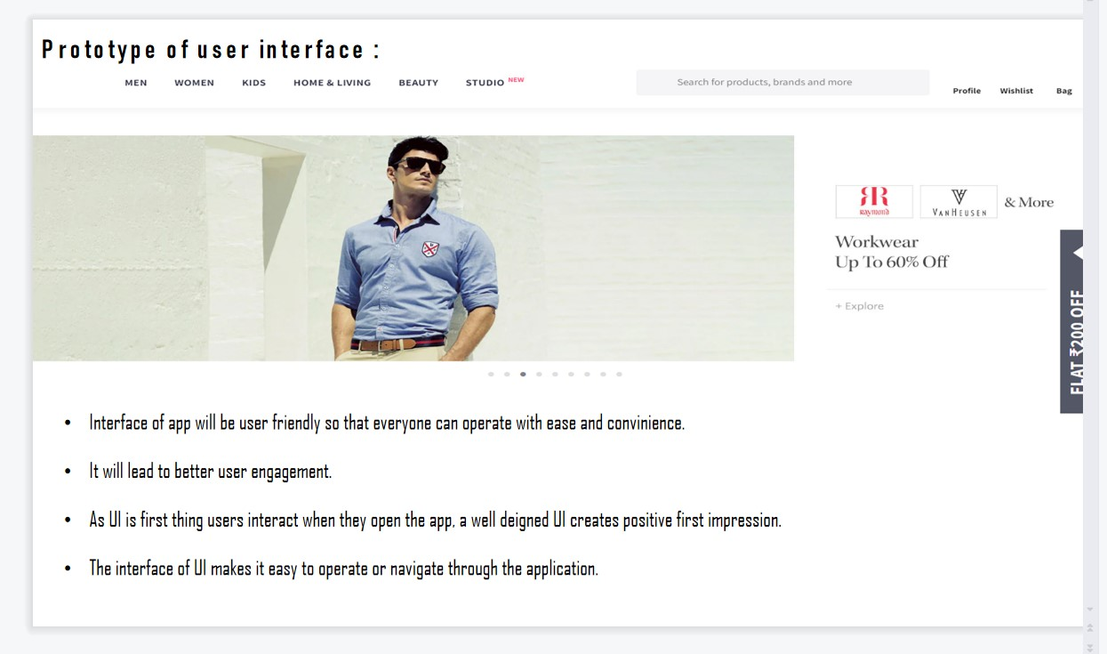

Slide 5
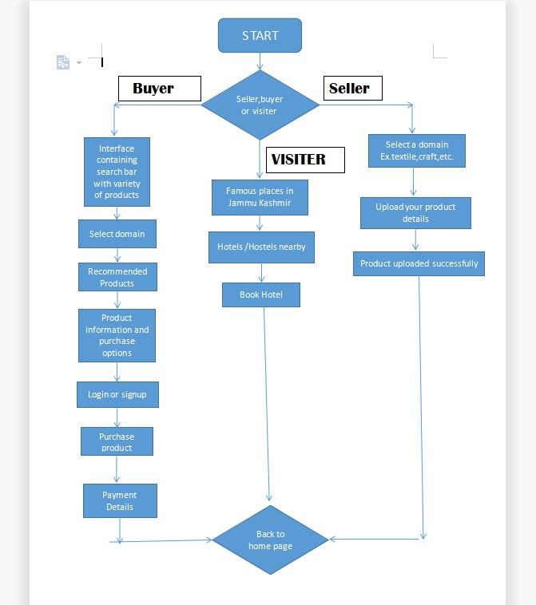
Idea/Approach Details
Describe your Dependencies / Show stopper here
Programming Langangauges:- python , JAVA Script, CSS
Firebase Authentication:- It is essential to authenticate users. This is used in building out secure user storage, email/phone verification flows,etc.
Push notifications:- For mobile apps use services like Firebase cloud Messaging(FCM) or Apple Push Notification service (APNS) to send push notifications.
UI / UX :- Managing the user journey as they interact with product.
Marketing and Promotion:- Python can help in marketing by enabling marketers to clean, process, and analyze large datasets.

Slide 6
Team Member Details
Team Leader Name: Shreyas Aher
Branch (Btech/Mtech/PhD etc): BE Stream (ECE, CSE etc): CSE Year (I,II,III,IV): II
Team Member 1 Name: Vedanti Patekar
Branch (Btech/Mtech/PhD etc):BE Stream (ECE, CSE etc): CSE Year (I,II,III,IV): II
Team Member 2 Name: Shreya Khadilkar
Branch (Btech/Mtech/PhD etc):BE Stream (ECE, CSE etc): CSE Year (I,II,III,IV): II
Team Member 3 Name: Avishkar Bhusare
Branch (Btech/Mtech/PhD etc):BE Stream (ECE, CSE etc):CSE Year (I,II,III,IV): II
Team Member 4 Name: Hariom Pawar
Branch (Btech/Mtech/PhD etc):BE Stream (ECE, CSE etc):CSE Year (I,II,III,IV): II
Team Member 5 Name: Onkar Dhumal
Branch (Btech/Mtech/PhD etc):BE Stream (ECE, CSE etc):CSE Year (I,II,III,IV): II
Team Mentor 1 Name: Dr.Dattatray Waghole
Category (Academic/Industry): Academic Expertise (AI/ML/Blockchain etc): Domain Experience (in years):
Team Mentor 2 Name: Prof.Nitin Zinzurke
Category (Academic/Industry):Academic Expertise (AI/ML/Blockchain etc): Domain Experience (in years):

Slide 7
THANK YOU!

